Slide 1
Setting up the working environment

Slide 2
Setting up the working environment
We will need to install Anaconda
Anaconda is a software package that contains Python and Jupyter Notebook
It also contains many useful libraries (NumPy, pandas, …)
We will need to also install the required packages to use TensorFlow

Slide 3
Why Python?
You have a lot of choices, but usually you see projects made in Python or R. But why are we going to use Python?
Python is:
easy to learn
general-purpose
very high-level
very nice and useful packages for ML (for example, scikit learn)
also free!

Slide 4
Why Python?
Isn’t Python very slow?
Yes, it is ~100x slower than C
But several packages are actually written in C/C++
well, even Python is…
Also, integration with heterogenous programming makes it a good choice for ML

Slide 5
Why Jupyter Notebook?
Jupyter is a server-client application that:
runs your code in your web-browser
it’s used at Google, Microsoft, IBM, …
incorporates several languages and allows easy sharing

Slide 6
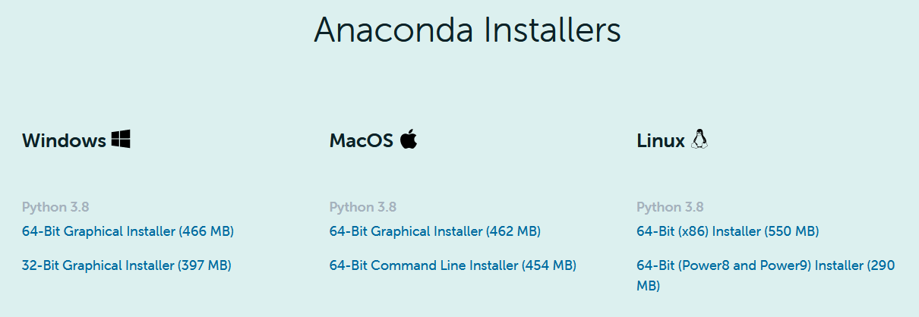
Installing Anaconda
Go to: https://www.anaconda.com/distribution/
Select your OS
Download Python 3.8 (64-bit)

Slide 7
Installing Anaconda
For compatibility issues, check: “Register Anaconda as my default Python 3.8”
It could raise an alert if you already have Python installed
Don’t select the Anaconda Cloud

Slide 8
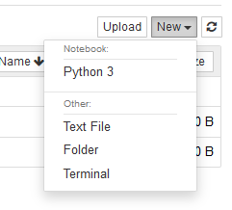
Let’s start
Run Jupyter Notebook (now installed with Python)
It will open in the Browser
Don’t close the “shell” window that might open
Jupyter uses IPython Notebook Format (.ipynb)
Create a new Python 3 Notebook

Slide 9
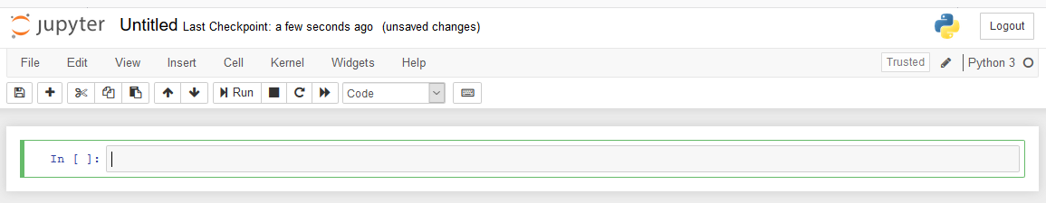
Let’s start
It should open a new tab like this:

Slide 10
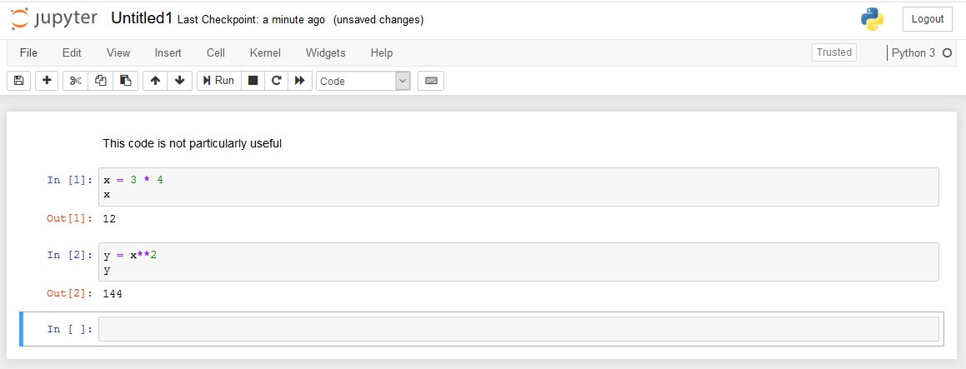
It splits the code in cells that you can run individually
Very nice for debugging!
Notes:
Select a Cell and click M to add a markdown
SHIFT + ENTER to run and create a new cell if none, or step to the next one
CTRL + ENTER to just run the cell
ALT + ENTER to run and create a new cell

Slide 11
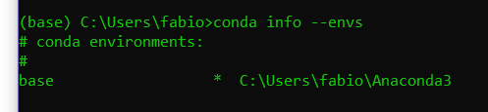
Installing TensorFlow 2.1.0
Run “Anaconda Prompt” from your OS Menu
Commands:
conda info --envs
conda create --name env_name python=3

Slide 12
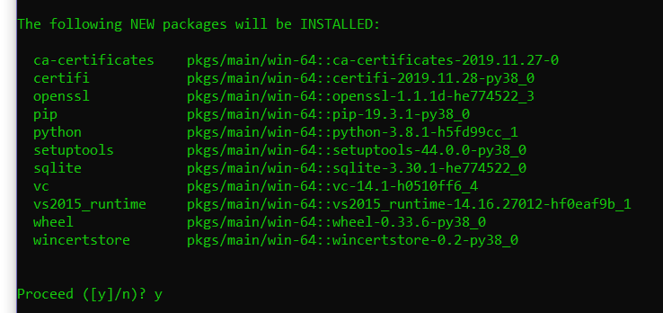

Slide 13
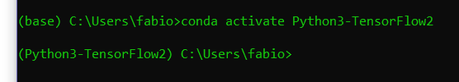
Installing TensorFlow 2.1.0
Commands:
conda activate env_name
conda install tensorflow
pip install –-upgrade tensorflow
pip install ipykernel
ipykernel installation ensures that Jupyter has the right kernel
Notes:
Before the commands shown here:
pip install --upgrade grpcio
I found some compatibility issues with the older version installed

Slide 14
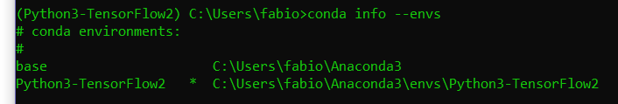
Installing TensorFlow 2.1.0
Finally:
python -m ipykernel install --name env_name
conda info --envs

Slide 15
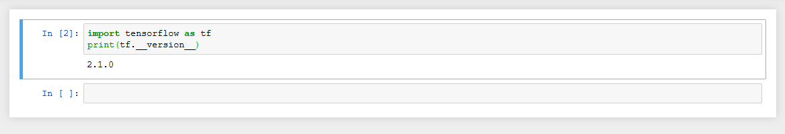
Installing TensorFlow 2.1.0
Now, close and open again Jupyter to test if everything went right
Be sure to select the right Kernel

Slide 16
Installing Packages
Let’s install scikit-learn and the TensorFlow datasets
pip install scikit-learn
pip install tensorflow-datasets

Slide 17
Let’s “machine learning” with Numpy

Slide 18
Elements of the model in supervised learning
Inputs
Weights
Biases
Targets
Outputs

Slide 19
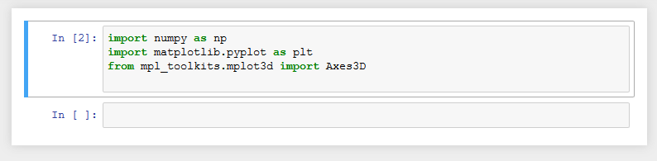
Import the relevant libraries
First: pip install matplotlib
Then:
Matplotlib and Axes3D are not required, but they make cool graphs

Slide 20
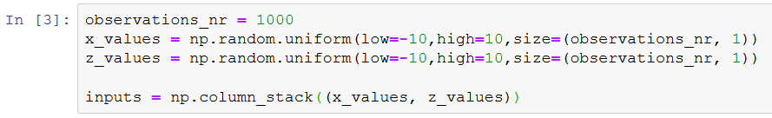
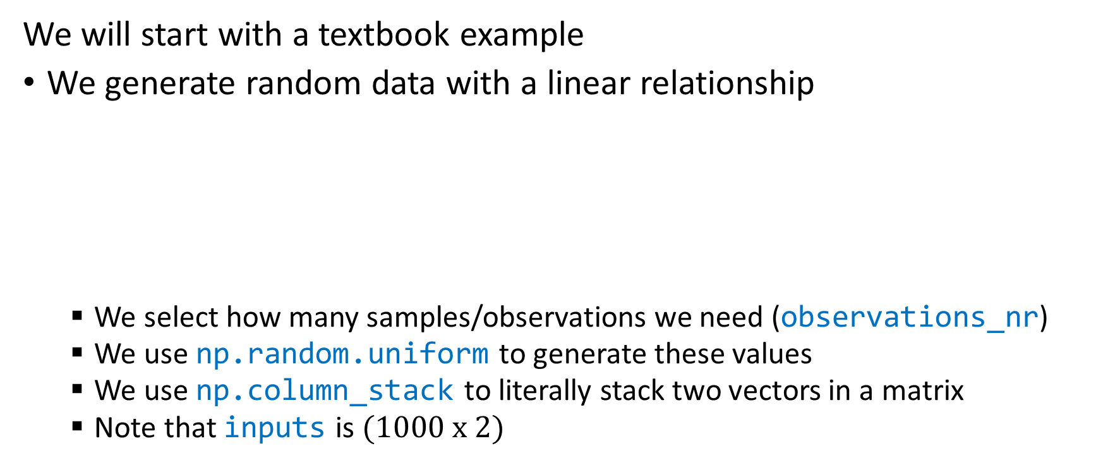
Generating random input data for training
We will start with a textbook example
We generate random data with a linear relationship
We select how many samples/observations we need (observations_nr)
We use np.random.uniform to generate these values
We use np.column_stack to literally stack two vectors in a matrix
Note that inputs is $(1000 x 2)$

Slide 21

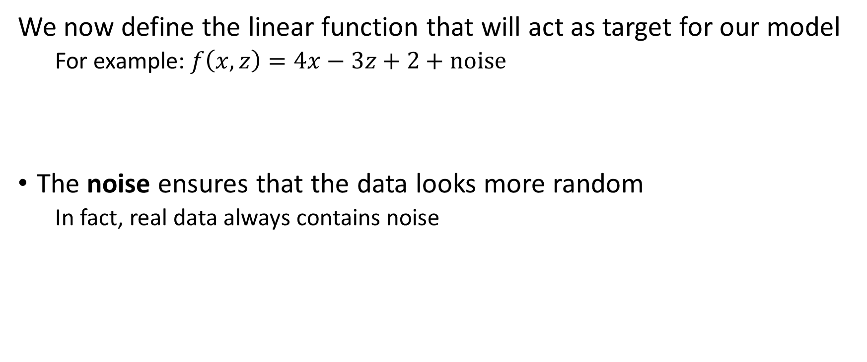


Create Targets
We now define the linear function that will act as target for our model
For example: $f\left(x,z\right)=4x−3z+2+noise$
The noise ensures that the data looks more random
In fact, real data always contains noise
$$w_{1}$$
$$w_{2}$$
$$b$$

Slide 22
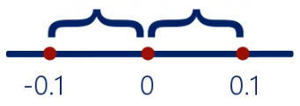

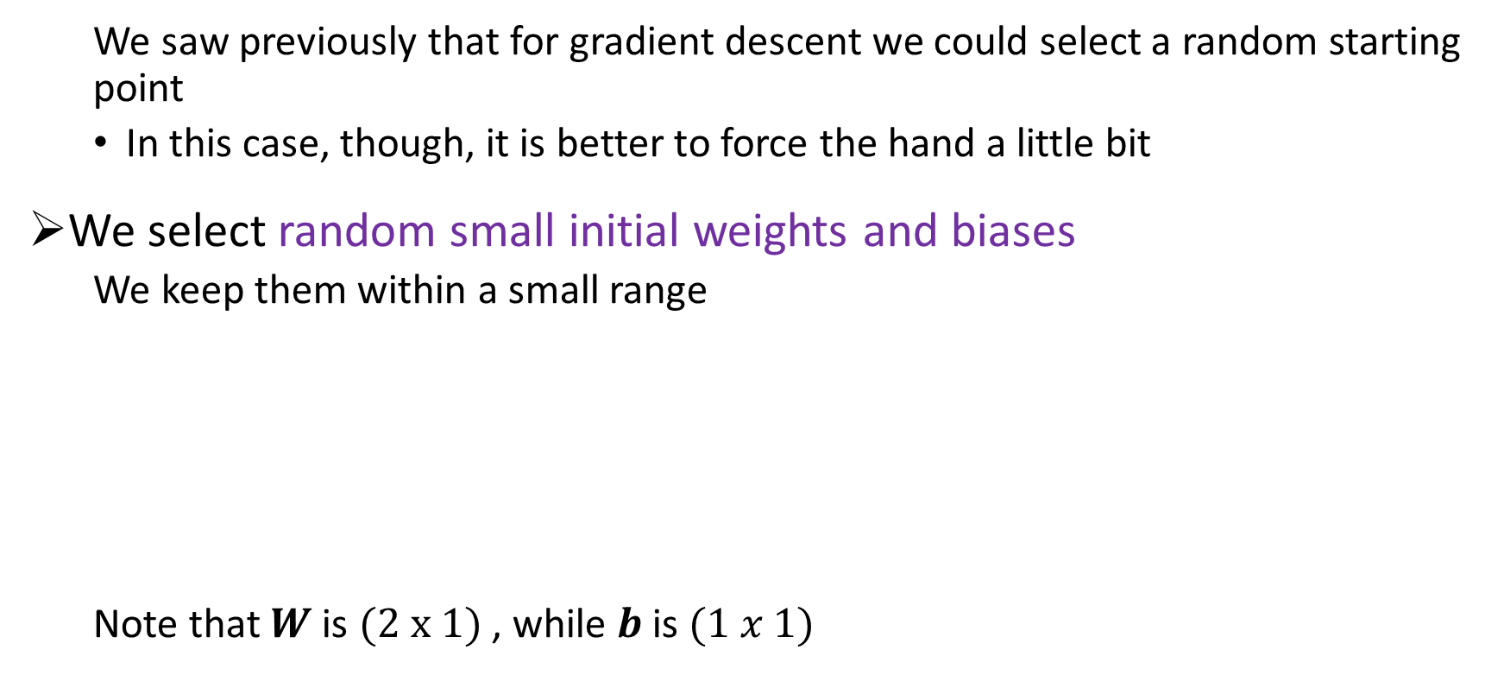
Let’s set up the initial variables
We saw previously that for gradient descent we could select a random starting point
In this case, though, it is better to force the hand a little bit
We select random small initial weights and biases
We keep them within a small range
Note that $W$ is $(2 x 1)$ , while $b$ is $(1 x 1)$

Slide 23

Now, let’s set up the leaning rate
You can try different values and see what happens.
Here an example:
Okay, we are all set.
Notes:
You can try with 0.2 and see that it doesn’t work…

Slide 24
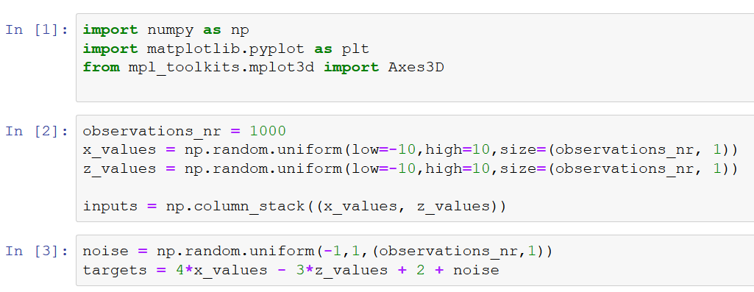

Slide 25
Elements of the model in supervised learning
Inputs
Weights
Biases
Targets
Outputs

Slide 26
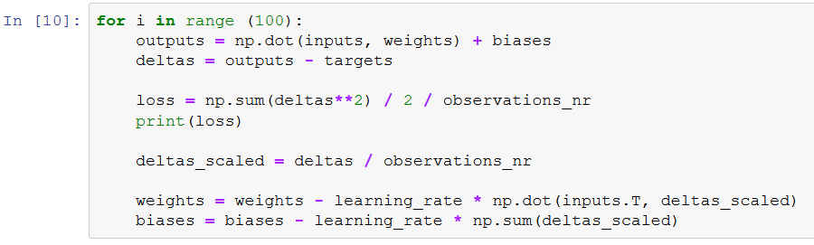
We can now train the model
We run the algorithm over 100 iterations
This is an arbitrary number
For this problem, it is more than enough

Slide 27
We can now train the model
We calculate the outputs for the given weights and biases
They were random, so likely far from the targets

Slide 28
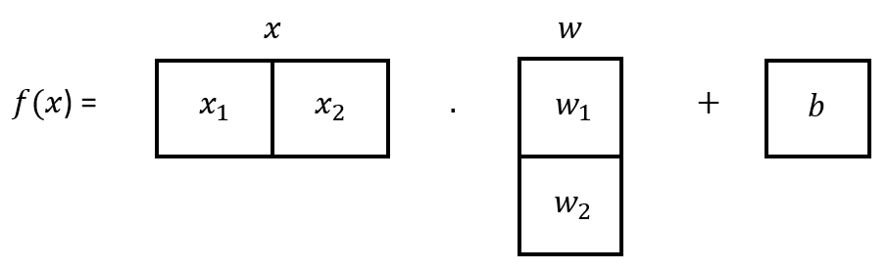

We can now train the model
$$f\left(x\right)=x_{1}∗w_{1}+x_{2}∗w_{2}+b$$

Slide 29
We can now train the model
We compute the deltas, that is, the error between outputs and targets

Slide 30
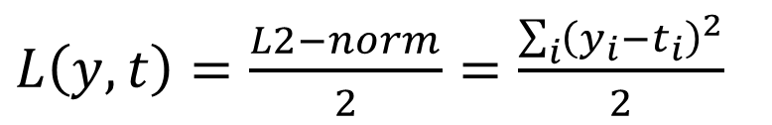
We can now train the model
We compute the Loss function that compares the outputs with the targets
We used:
$L\left(y,t\right)=\frac{L2−norm}{2}=\frac{\sum_{i}{{\left(y_{i}−t_{i}\right)}^{2}}}{2}$
Notes:
We used the “square loss”, but other functions can be tested

Slide 31
We can now train the model
We also divided by the number of observations
We do this to make the learning independent of the number of observations
Also, it does not affect the logic of the Loss (it’s just a division by a constant)

Slide 32
We can now train the model
We print the loss because we want to see if it is decreasing
Otherwise, we need to change the learning rate

Slide 33
We can now train the model
Even this step is done to make the algorithm independent of the number of observations

Slide 34

We can now train the model
We update the weights and the biases following the gradient descent methodology
Note the inputs.T
We are computing the transpose
$$w_{i+1}=w_{i}−η∇_{w}L(y,t)$$
$$b_{i+1}=b_{i}−η∇_{b}L(y,t)$$

Slide 35
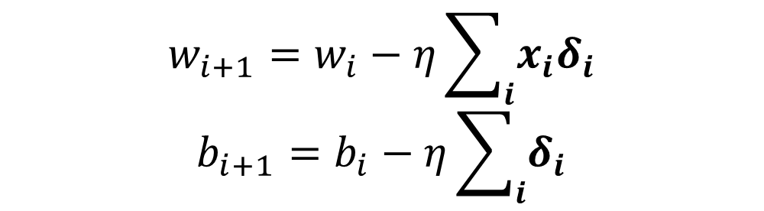
We can now train the model
We update the weights and the biases following the gradient descent methodology
Note the inputs.T
We are computing the transpose
$$w_{i+1}=w_{i}−η\sum_{i}{x_{i}δ_{i}}$$
$$b_{i+1}=b_{i}−η\sum_{i}{δ_{i}}$$

Slide 36
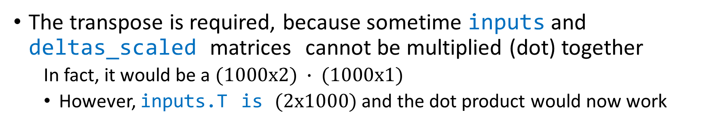
We can now train the model
The transpose is required, because sometime inputs and deltas_scaled matrices cannot be multiplied (dot) together
In fact, it would be a $(1000x2) ∙ (1000x1)$
However, inputs.T is $(2x1000)$ and the dot product would now work
Notes:
Not that the output of the dot product is (2x1), as the weights matrix

Slide 37
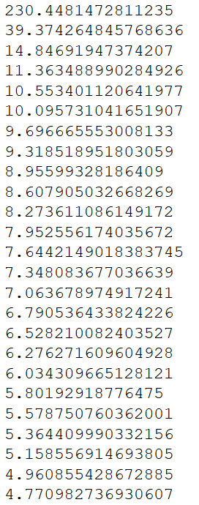
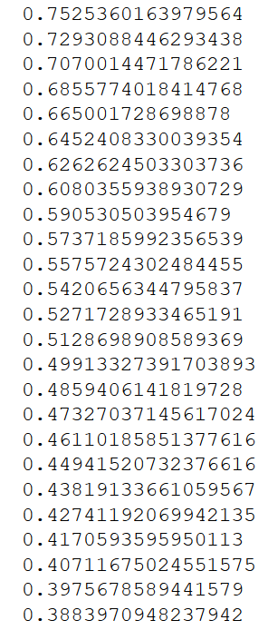
…
It’s fast
It’s minimizing the error (Loss function)
We trained the model correctly!
Notes:
If you run the previous code, you should see a series of numbers (the output of the Loss function) that decreases constantly
Try different $η$ values to see what happens.
NOTE: your output will very likely be different, because different random weights, biases and points would be generated

Slide 38
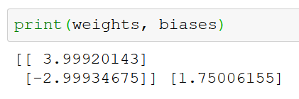
Bonus: let’s check
$$f\left(x,z\right)=4x−3z+2+noise$$
The weights seem right.
The bias… almost. Why is that?
Probably, not enough iterations (100) or not perfect learning rate

Slide 39
Bonus: let’s check
$$f\left(x,z\right)=4x−3z+2+noise$$
Let’s run again the block in Jupyter that contains the loop
This will run just that part of the code, so obtaining other 100 iterations

Slide 40
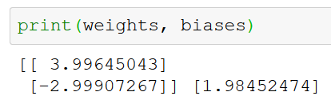
Bonus: let’s check
$$f\left(x,z\right)=4x−3z+2+noise$$
If we print again the values we get so much closer!

Slide 41
Recap of the “tuning” parameters
Number of observations
Learning rate
Number of iterations (or, better, epochs)
Initial range for initializing the weights and biases
Notes:
epoch is a synonym of iteration over the full dataset

